Slide 1
3-4-2025

Slide 2
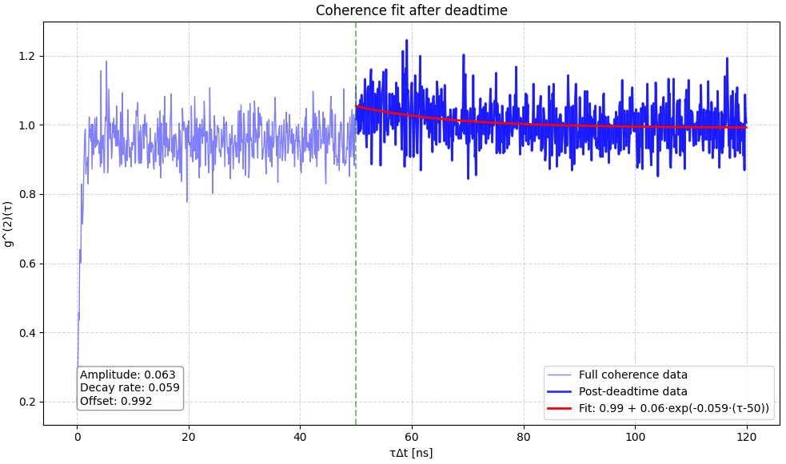
Let’s try to fit the dead time peak.
1 emitter, 330kW/cm2

Slide 3
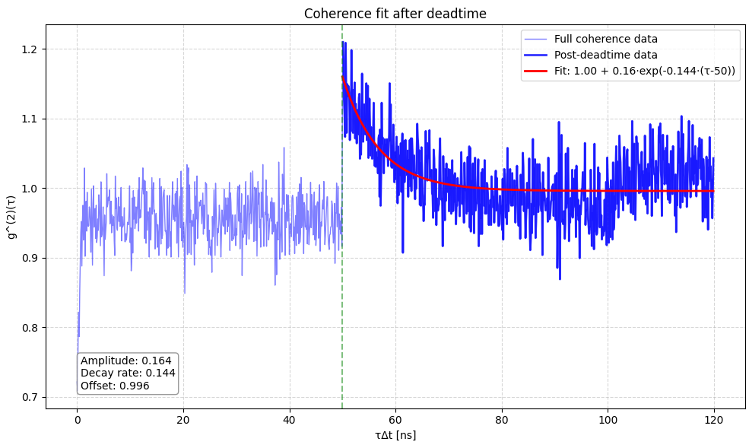
3 emitters, 550 kW/cm^2

Slide 4
Is there a relation between the excitation rate and the decay rate of the deadtime peak?

Slide 5
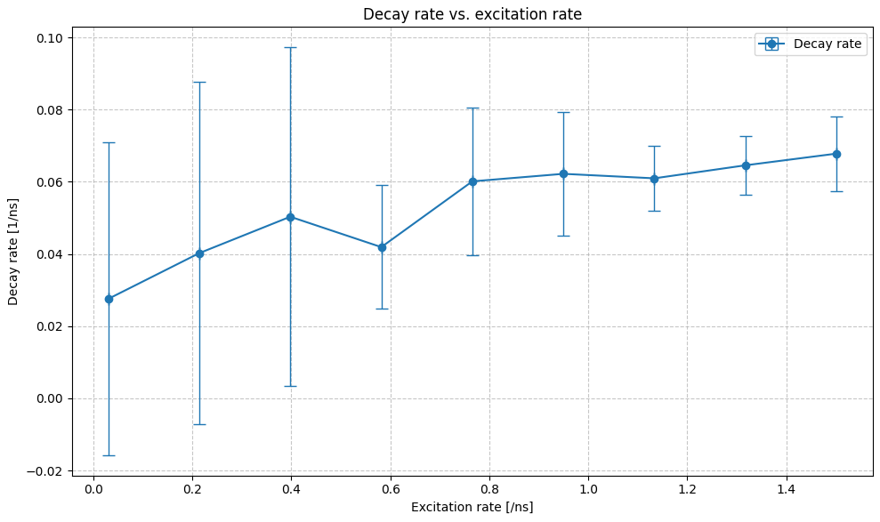
1 emitter

Slide 6
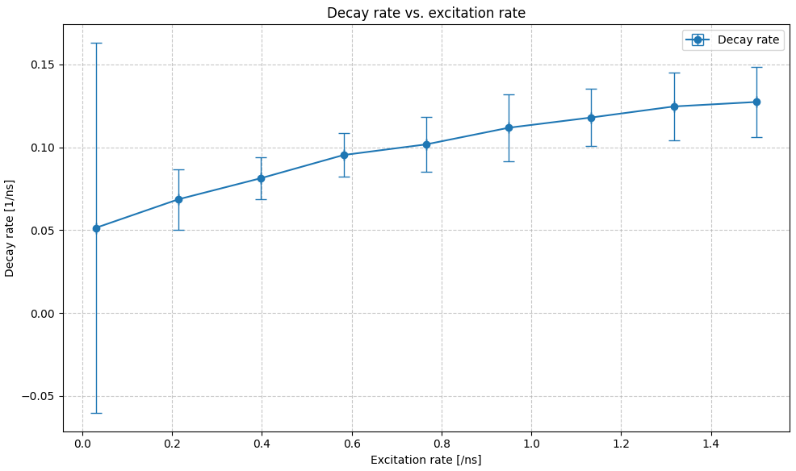
3 emitters

Slide 7
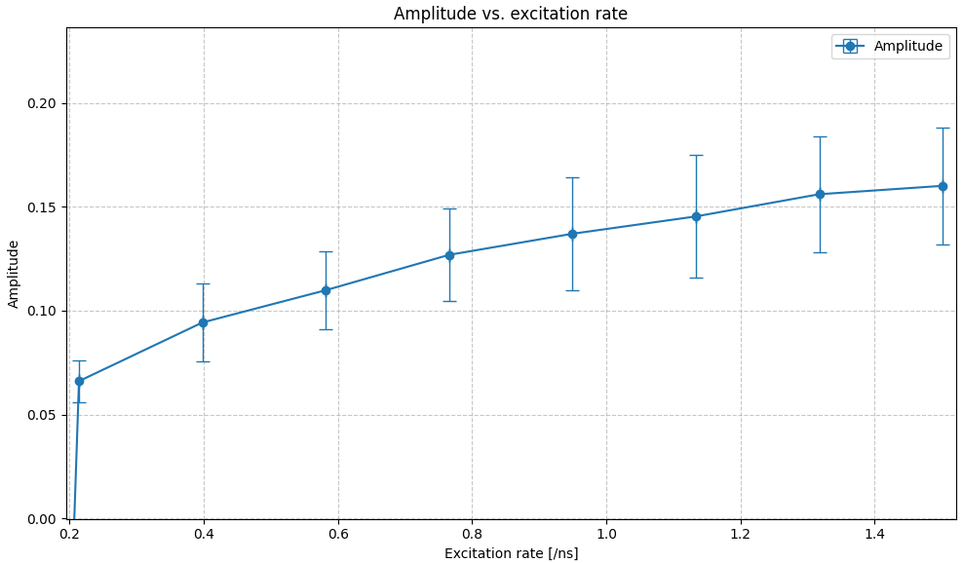
Amplitude A: height of deadtime peak

Slide 8
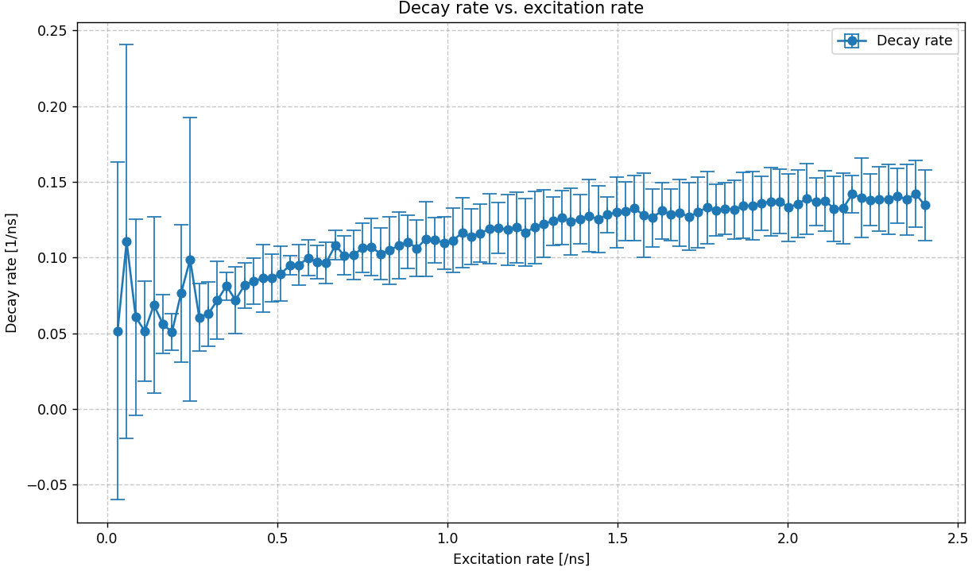

Slide 9

Higher decay rate => steeper drop-off
$1−Ae^{−d(τ−τ_{dt})}=1 −Ae^{−\ln\left(k_{ex}\right)(τ−τ_{dt})}=1 −A{(k_{ex})}^{−(τ−τ_{dt})}$

Slide 10
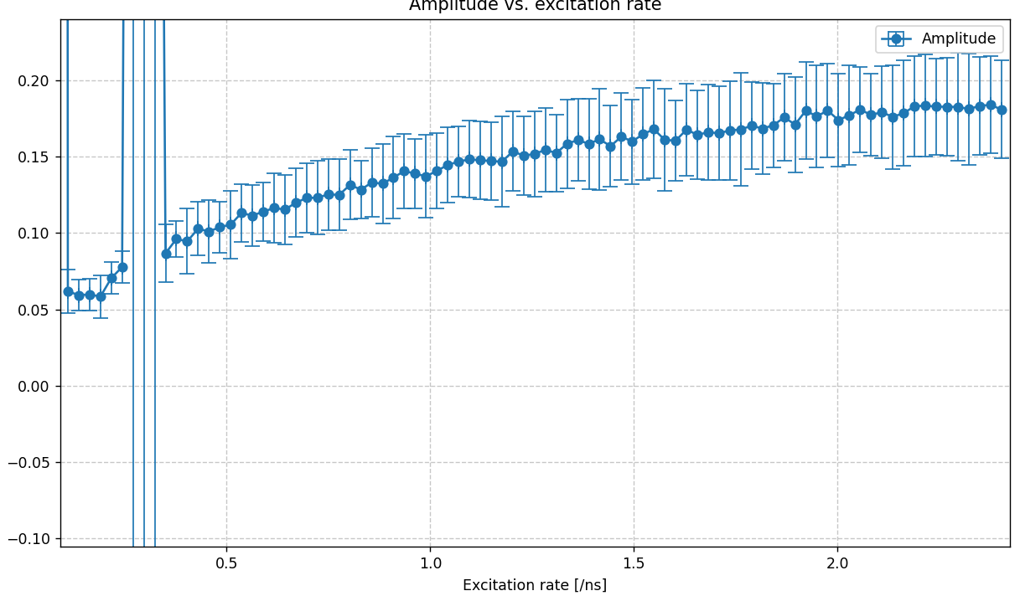

Slide 11
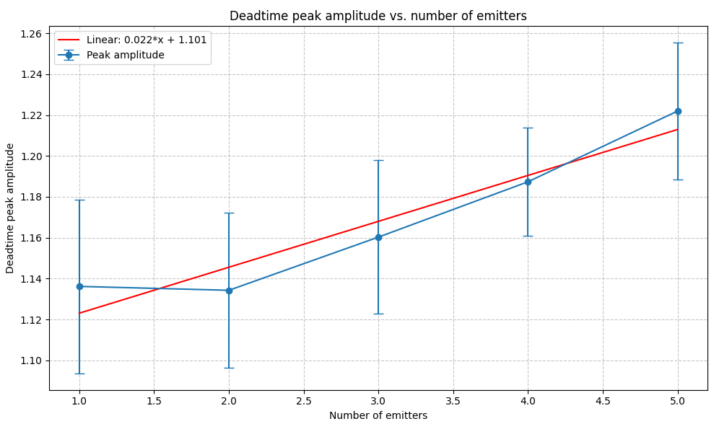
Deadtime peak amplitude vs # emitters
Errorbars: variation in 20 simulations
Laser: 300 kW/cm2
Deadtime: 50ns
Bins: 0.1ns

